Slide 1

INSURANCE ANALYTICS
SUBMITTED TO
-Francis Rodrigues
B2019032 Muskan
B2019034 Prachi
B2019055 Sushant
B2019059 Vividh
B2019077 Himanshi
Group 9

Slide 2
Data Description and
Classification techniques
Techniques Used
38 Columns
Independent Variables:- 37,
Dependent Variable:- 1,
Dependent Variable Type: Binary and categorical
Random Forest
Grid Search CV
Understanding the problem statement
Prepare a Machine Learning Model to predict the Persistency 13M Payment Behaviour at the New Business stage.
ROADMAP

Slide 3
DATA PREPRATION
Missing Values Treatment
Categorical Values
Numerical values
High Percentage
Low Percentage
Bucketing
Label Encoding
Outlier Detection

Slide 4
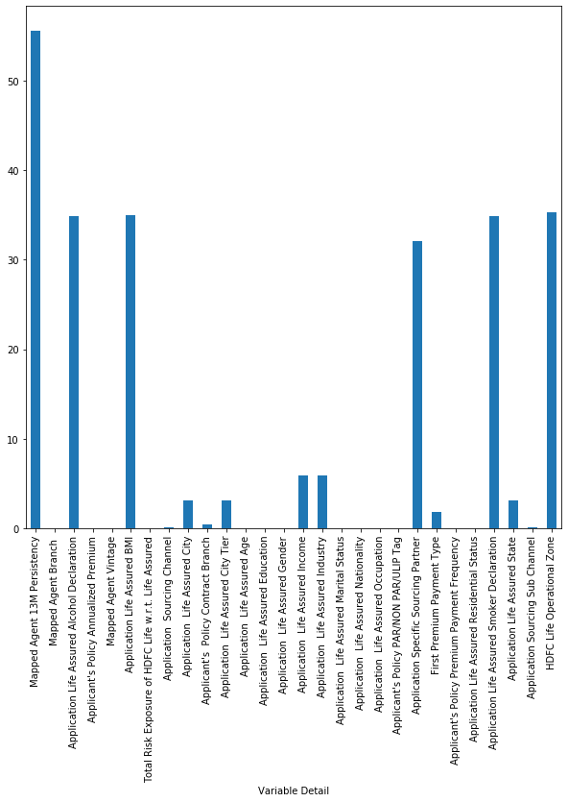
Missing Values Treatment
We found 28 Columns out of 38 has the missing values.
The Missing Values in the Data Frame was huge.
We divided it into two categories
High Percentage of Missing Value.
Low Percentage of Missing Value.
*Removed the rows which contains low missing value percentage
*We deleted 11032 rows from the data frame.
Percentage Distribution of Missing Values in Data Frame

Slide 5
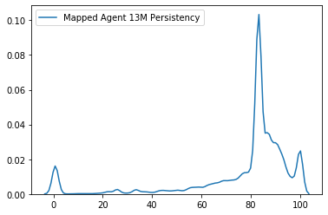
Missing Values Treatment
High Percentage of Missing Values
Mapped Agent 13M Persistency
Application Life Assured BMI
Application Life Assured Alcohol Declaration
Application Specific Sourcing Partner
Application life Assured Smoker Declaration
HDFC Life Operational Zone
Steps Taken
Mapped Agent 13M Persistency contains 54.35% of missing Values, hence can’t remove all the rows.
Found it’s mean and median, mean was 77.81 and median was 83.01
Imputed it’s value by Median.
*We removed rest of the rows as we can’t impute there values as they were categorical in nature.
Our Final Shape of Data frame (25320,38)
All were having Missing Value percentage greater than 30%

Slide 6
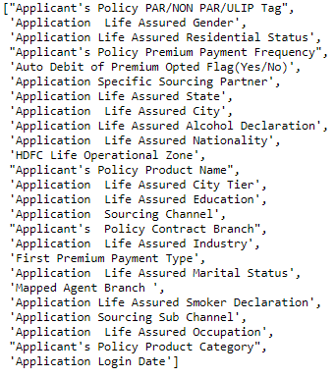
Categorical Values Treatment
To treat the Categorical Variable we used the concept of Bucketing and Label Encoding.
The Columns which were having 4 or less than 4 categories like Gender, Auto Debit Premium,etc, we simply created their Dummy Variables.
Columns having Categorical Values

Slide 7
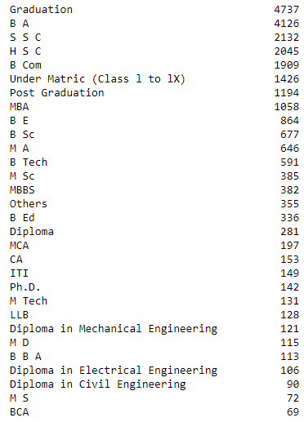
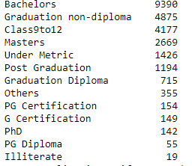
Categorical Values Treatment- Bucketing
What is Bucketing?
Create a dictionary mapping by enumerating (similar to creating a dictionary from a list by creating dictionary keys from the list indices)
As we can see there are various categories of “Application Life Assured Education”.
To over come this we will use the concept of Bucketing .

Slide 8
Handling Categorical Variables (Bucketing)
Mapped Agent city
others 14874
Delhi 2462
Mumbai 1877
Chennai 1511
Pune 872
Kolkata 802
Ahmedabad 642
Bangalore 600
Hyderabad 578
Chandigarh 552
Jaipur 550
Mapped Agent Branch - Dropped
Application Life Assured Education
Main Categories:
Under Metric
Graduation non-diploma
Graduation Diploma
PG Diploma
Masters
Bachelors
Class9to12
PhD
PG Certification
G Certification
Application Sourcing Sub Channel
HDFC BANK 16516
HDFC Sales 3302
others 1379
Brokers 1367
HDFC Sec 890
Ratnakar Bank 809
HDFC BANK Upsell 656
Small CA 401
Applicant's Policy Contract city
others 13664
Mumbai 2377
Delhi 2310
Chennai 1231
Pune 841
Kolkata 793
Bangalore 677
Ahmedabad 585
Hyderabad 566
Chandigarh 533
Jaipur 526
Gurgaon 474
Surat 379
Indore 364
Application Life Assured State
others 4206
Maharashtra 4115
Gujarat 2561
Uttar Pradesh 2173
Punjab 2145
Tamil Nadu 1866
Delhi 1725
Haryana 1667
Rajasthan 1281
Madhya Pradesh 1007
West Bengal 971
Karnataka 968
Kerala 635

Slide 9
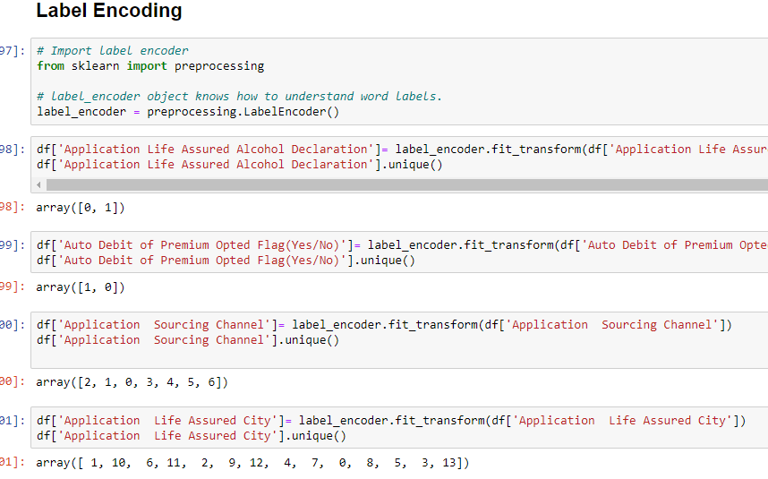
Categorical Values Treatment – Label Encoding
LABEL ENCODING
Label Encoding refers to converting the labels into numeric form so as to convert it into the machine-readable form. Machine learning algorithms can then decide in a better way on how those labels must be operated. It is an important pre-processing step for the structured dataset in supervised learning.
Advantage.
Label encoding can transform categorical data into numeric data
Model Learns Fast.
Label Encoding Implemented

Slide 10
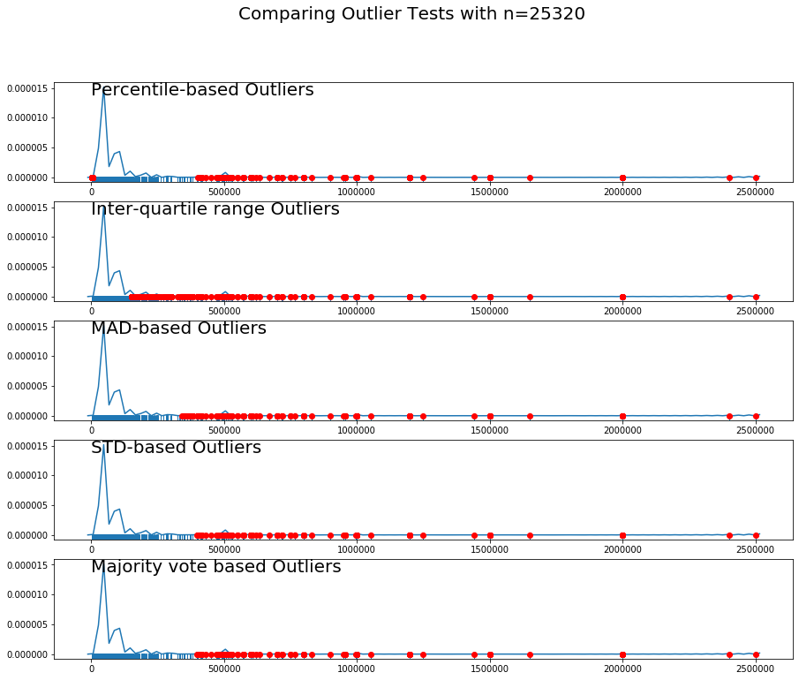
Numerical Values Treatment – Outlier Detection and Binning
Technique Used – Outlier Detection
Percentile based outlier detection
Inter quertile(IQR) range based outlier detection
Mean Absolute Deviation based outlier detection
Std deviation based outlier detection
Combination of outlier detecting algorithms
Applicant's Policy Annualized Premium
Set max value equal to min value of outlier using max voting algorithm. (max = 398120)

Slide 11
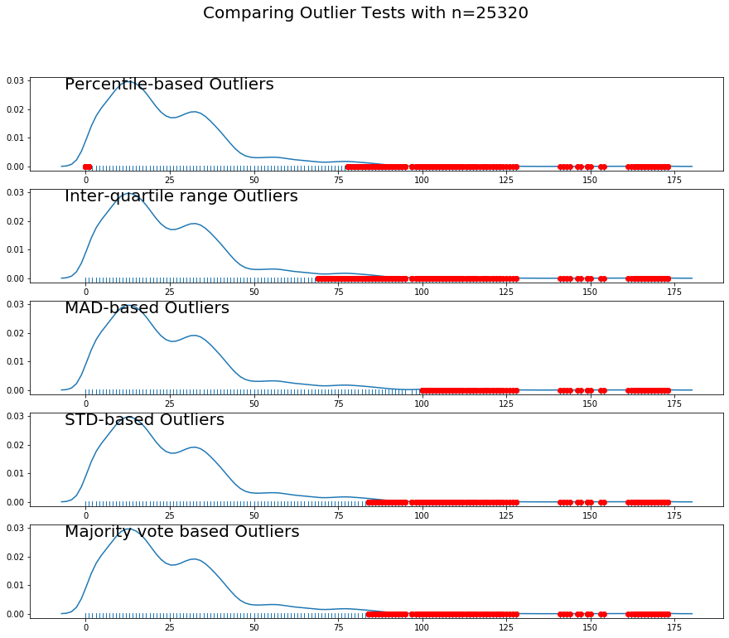
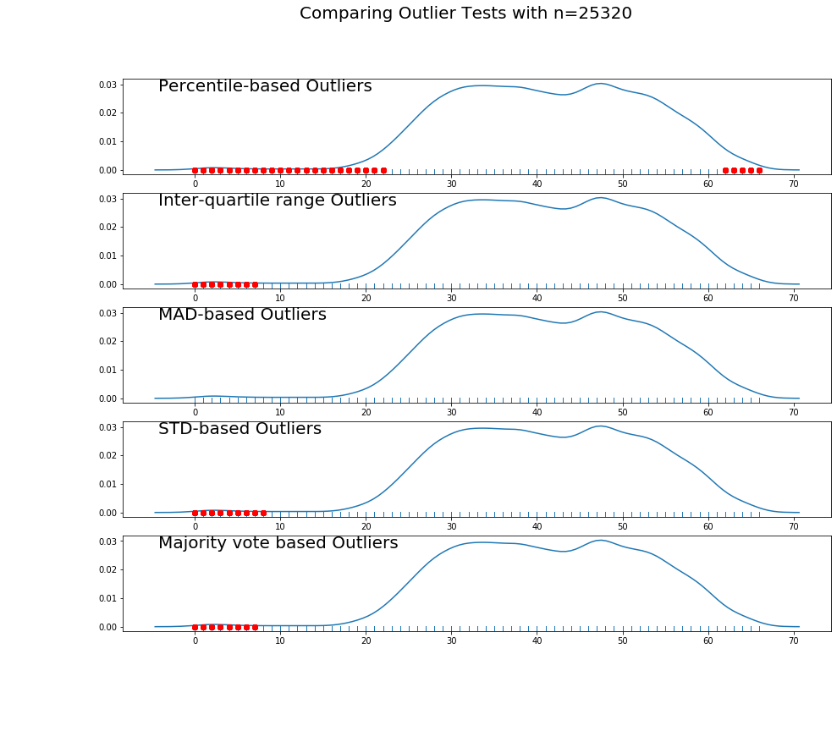
Mapped Agent Vintage
Application Life Assured Age
Set max value equal to min value of outlier using max voting algorithm. (max = 84)
Set min value equal to max value of outlier using max voting algorithm. (min = 7)

Slide 12
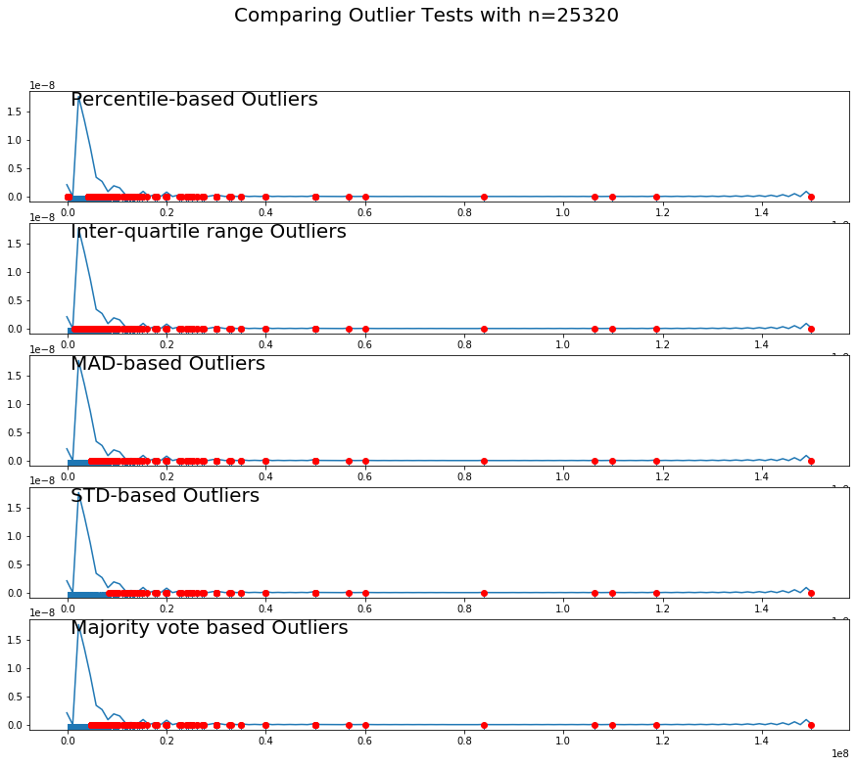
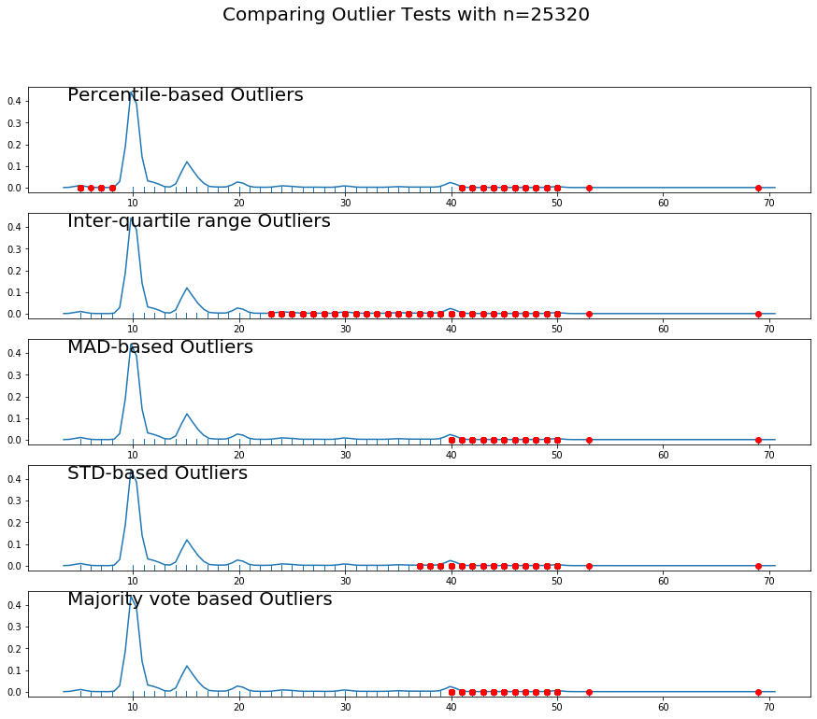
Application Life Assured Income
Applicant's Policy Risk Cessation Term
Set max value equal to min value of outlier using max voting algorithm. (max = 40)
Set max value equal to min value of outlier using standard deviation algorithm. (max = 8400000)

Slide 13
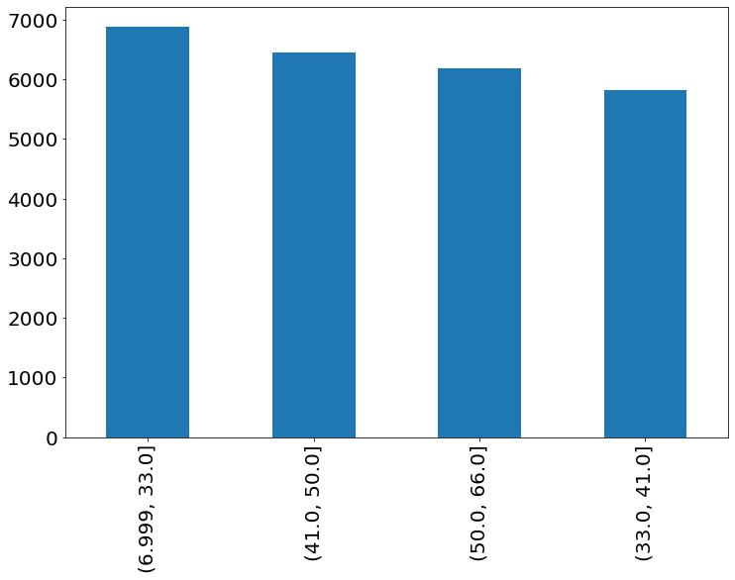
Numerical Values Treatment – Binning , Interaction Variable
Age Binning
BMI Categorization
Below 18.5 | Underweight
18.51 to 24.9 | Healthy weight
24.91 to 29.9 | Overweight
29.91 or higher | Obese
Derived Variables: Smoker+ Drinkers

Slide 14

DATA IS READY
LET’S BUILD THE MODEL

Slide 15
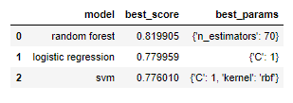
Grid Search CV
Grid search is the process of performing hyper parameter tuning in order to determine the optimal values for a given model.
What are hyperparameters?
Hyperparameters, are the parameters that cannot be directly learned from the regular training process. They are usually fixed before the actual training process begins. These parameters express important properties of the model such as its complexity or how fast it should learn.
Some examples of model hyperparameters include:
The penalty in Logistic Regression Classifier i.e. L1 or L2 regularization
The learning rate for training a neural network.
The C and sigma hyperparameters for support vector machines.
The k in k-nearest neighbors.
Our Grid Search CV result
We have created a K-Fold object with 5 splits

Slide 16
FEATURE SELECTION
Technique Used
Correlation Plot
OLS Regression Report
Feature Importance

Slide 17
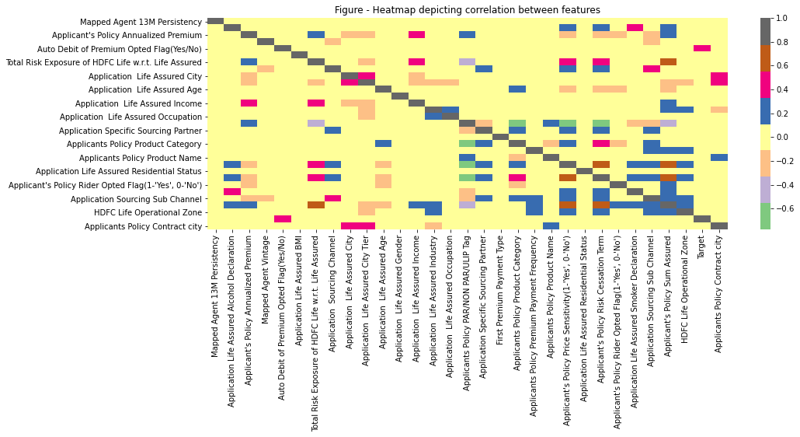
FEATURE SELECTION – Correlation Plot

Slide 18
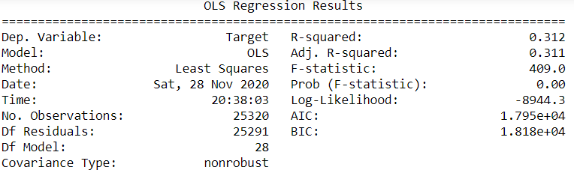
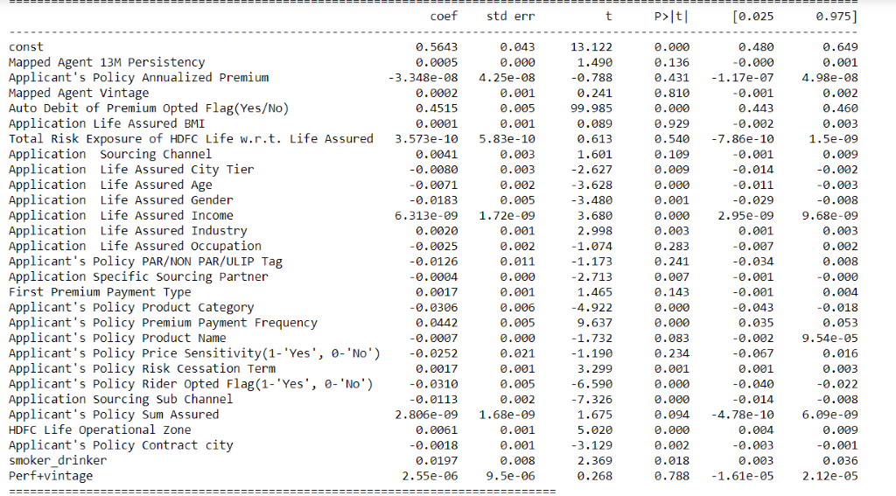
FEATURE SELECTION – OLS Regression Report

Slide 19
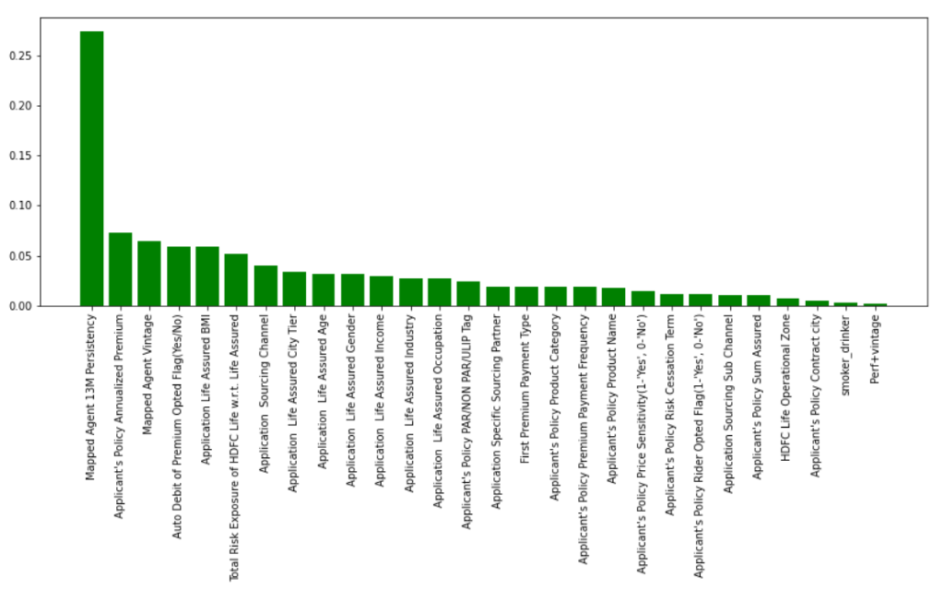
FEATURE SELECTION – Feature Importance Plot

Slide 20
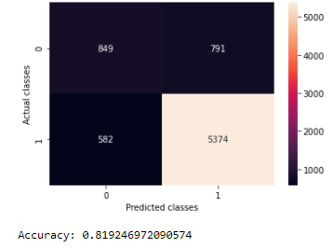
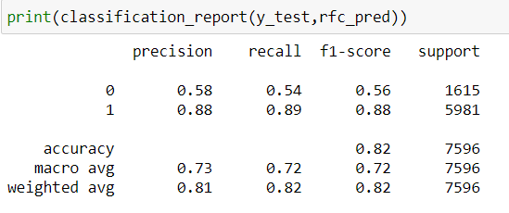
MODEL – RANDOM FOREST
Random forests or random decision forests are an ensemble learning method for classification, regression and other tasks that operate by constructing a multitude of decision trees at training time and outputting the class that is the mode of the classes (classification) or mean prediction (regression) of the individual trees.
Random forests correct for decision trees' habit of overfitting to their training set.
Classification Report

Slide 21
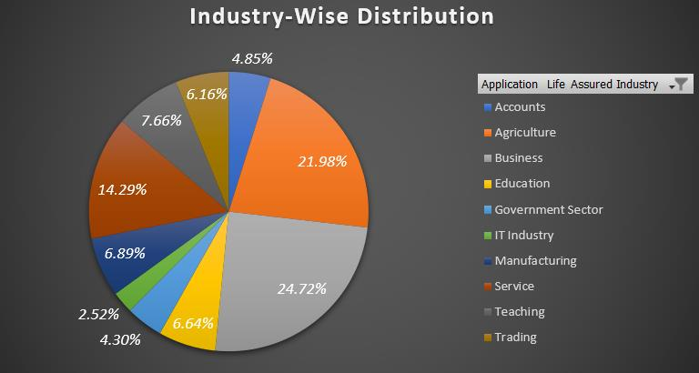
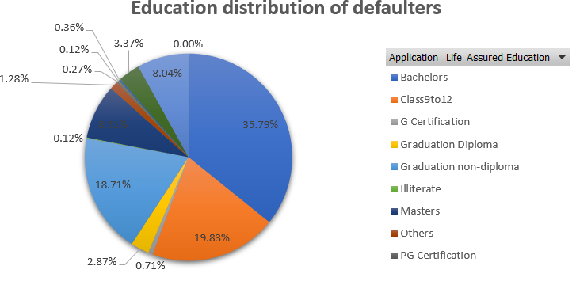
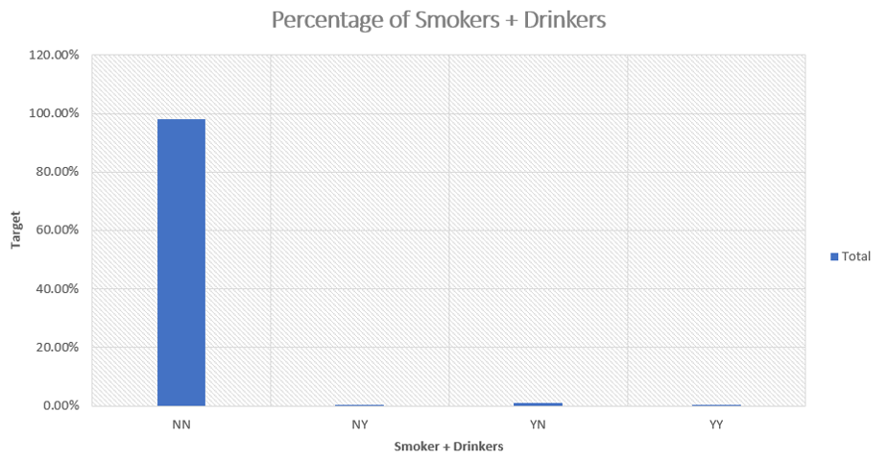
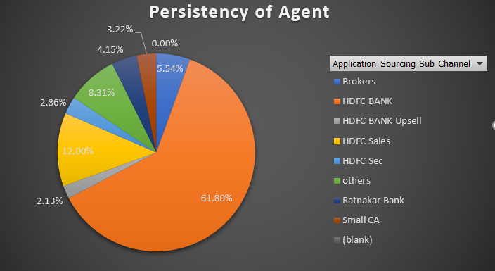
EDA – Non Payers

Slide 22

ANY QUESTIONS?

Slide 23

THANK YOU!

